Slide 1










Welcome to
News Reporter
Website
E-PROJECT_TEAM1

Slide 2


Meet
Our Instructor
Mr. To Hoang Anh

Slide 3

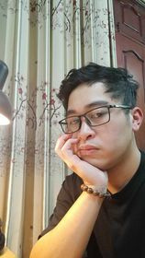
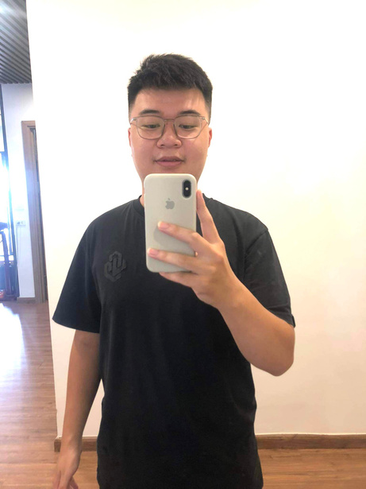
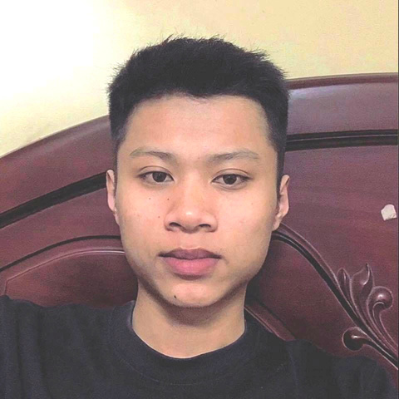
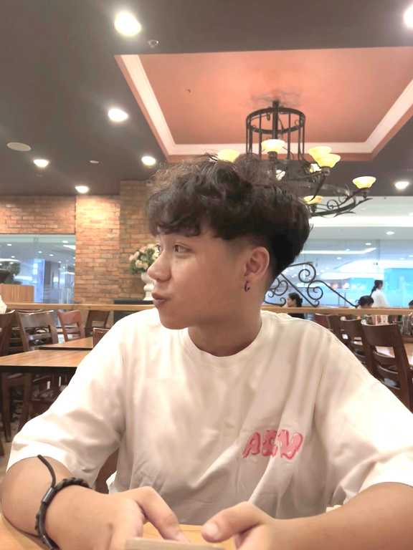

TEAM MEMBERS
TRINH TUAN HIEP
NGUYEN MINH DUC
DUONG VAN HIEP
NGUYEN VIET ANH
TRAN DUC MINH
Team Leader
Team Member
Team Member
Team Member
Team Member

Slide 4

News Reporter Website
NEWS REPORTER IS NOT JUST A FORM OF ENTERTAINMENT BUT ALSO AN EXCELLENT WAY TO EXPAND KNOWLEDGE AND STAY INFORMED ABOUT THE LATEST DEVELOPMENTS ACROSS VARIOUS FIELDS IN SOCIETY. THE PRESS PLAYS A CRUCIAL ROLE IN INFORMING THE COMMUNITY, PROVIDING A MULTIFACETED VIEW OF THE WORLD AROUND US.

Slide 5




SOFTWARE
1
Visual Studio Code
2
XAMPP
3
MySQL
4
Git
FORK GIT

Slide 6

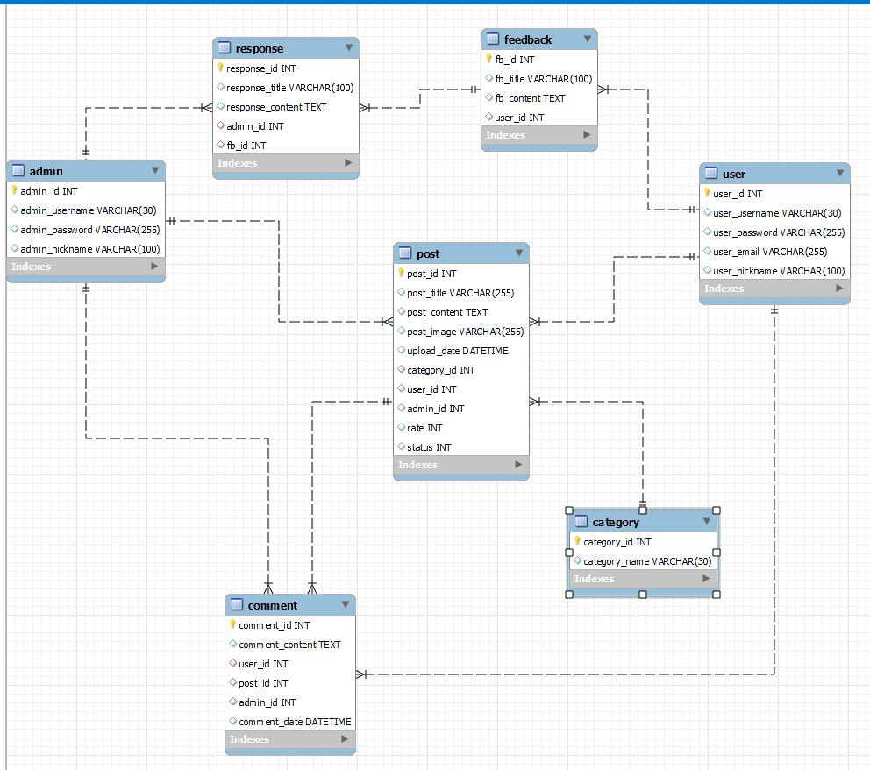
DATABASE
DESIGN

Slide 7
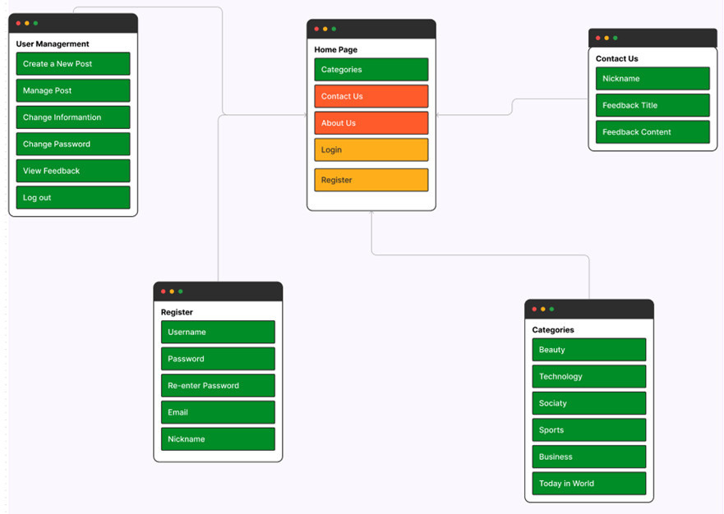
SITE MAP

Slide 8

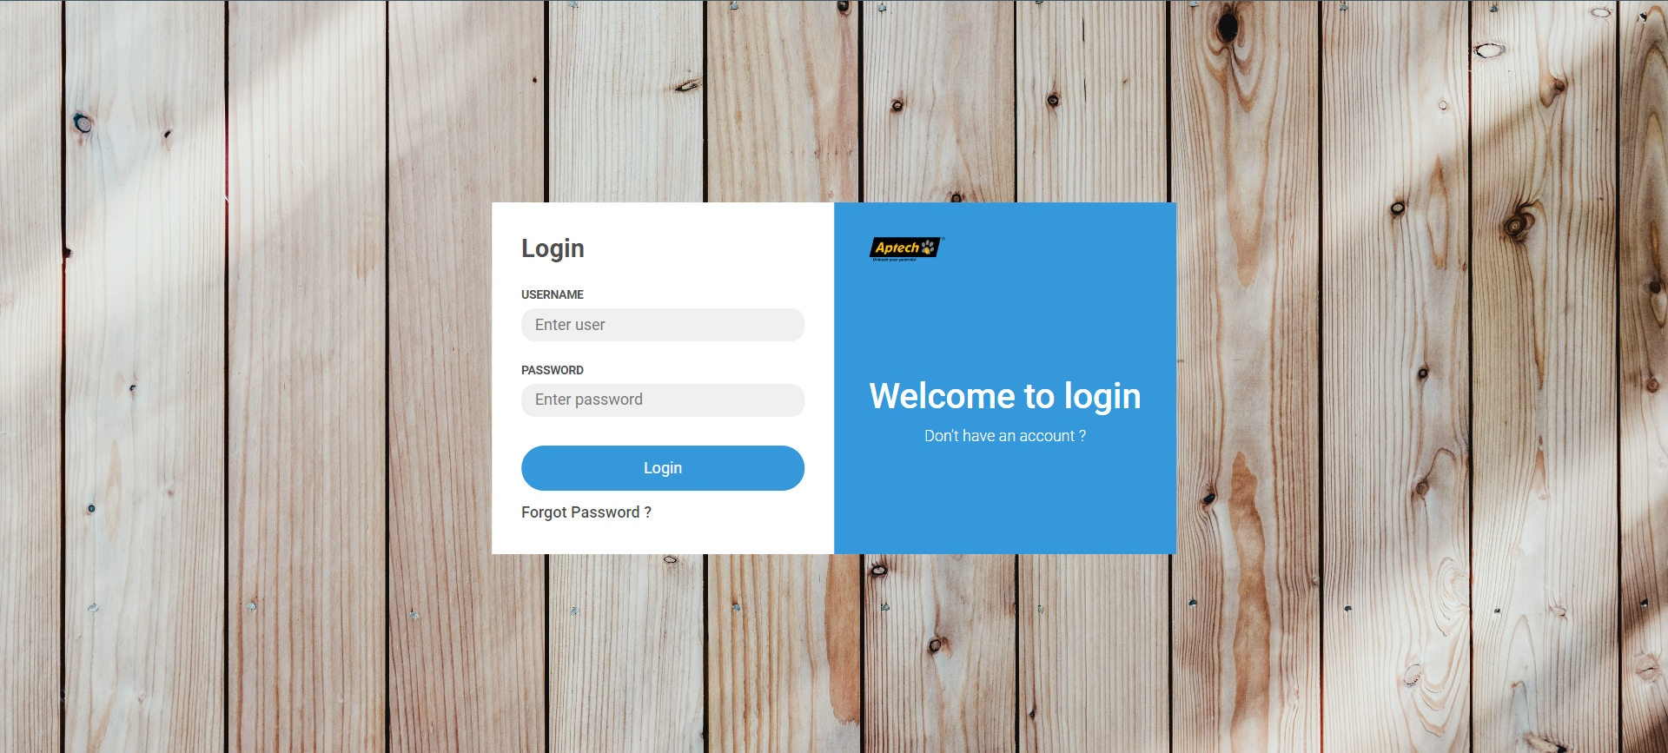

SIGN IN

Slide 9
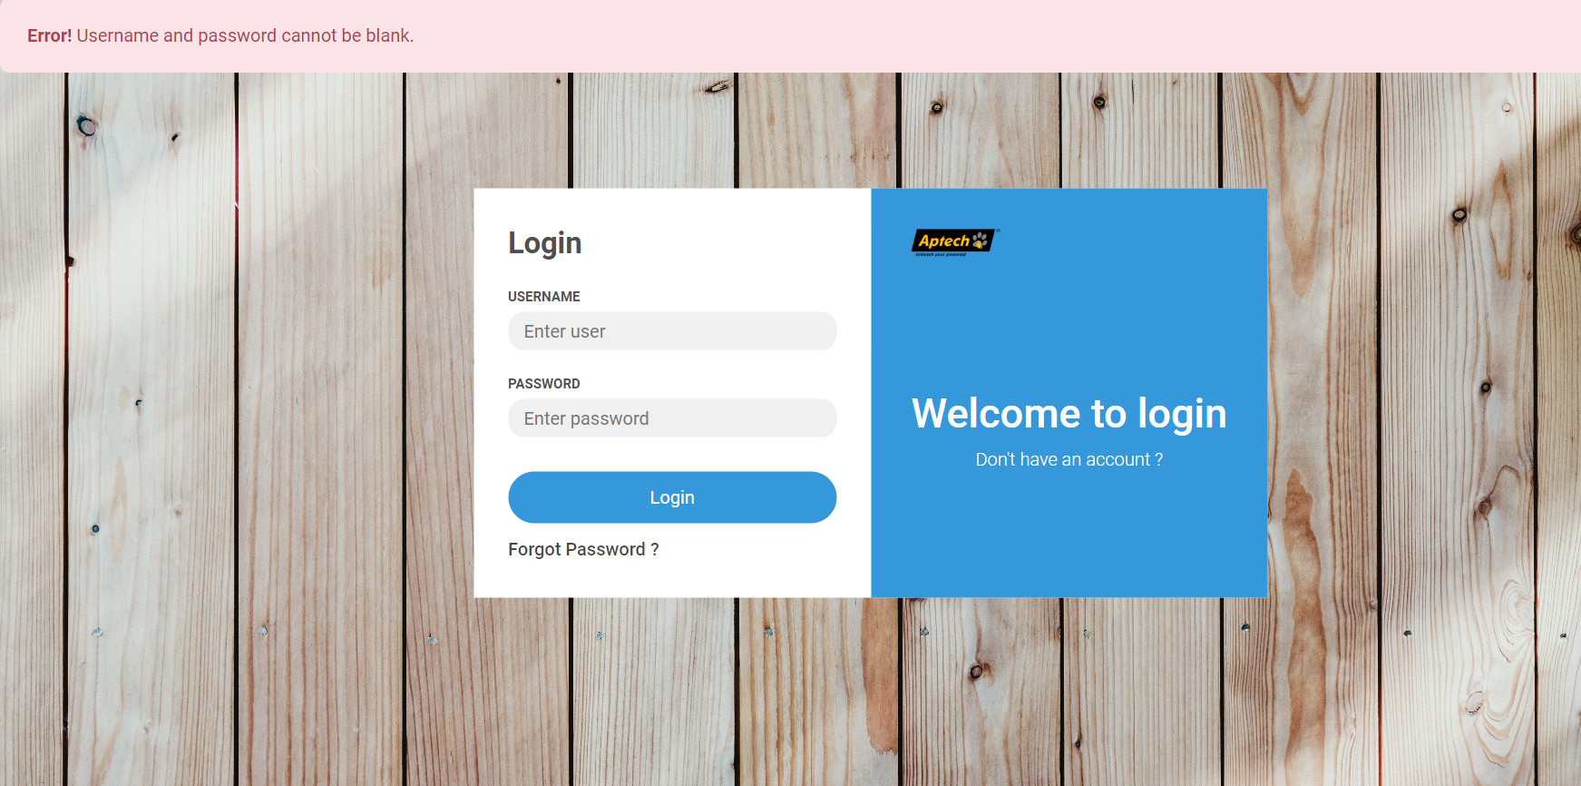
SIGN IN

Slide 10
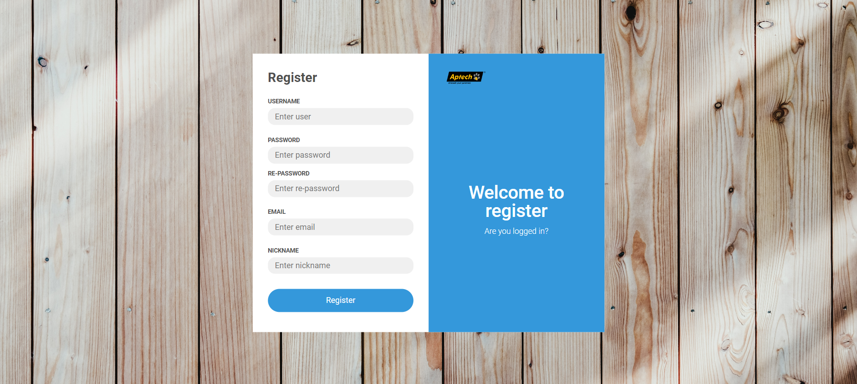
SIGN UP

Slide 11

SIGN UP

Slide 12
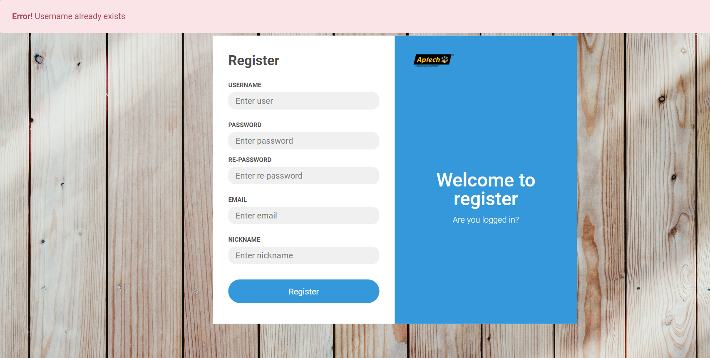
SIGN UP

Slide 13
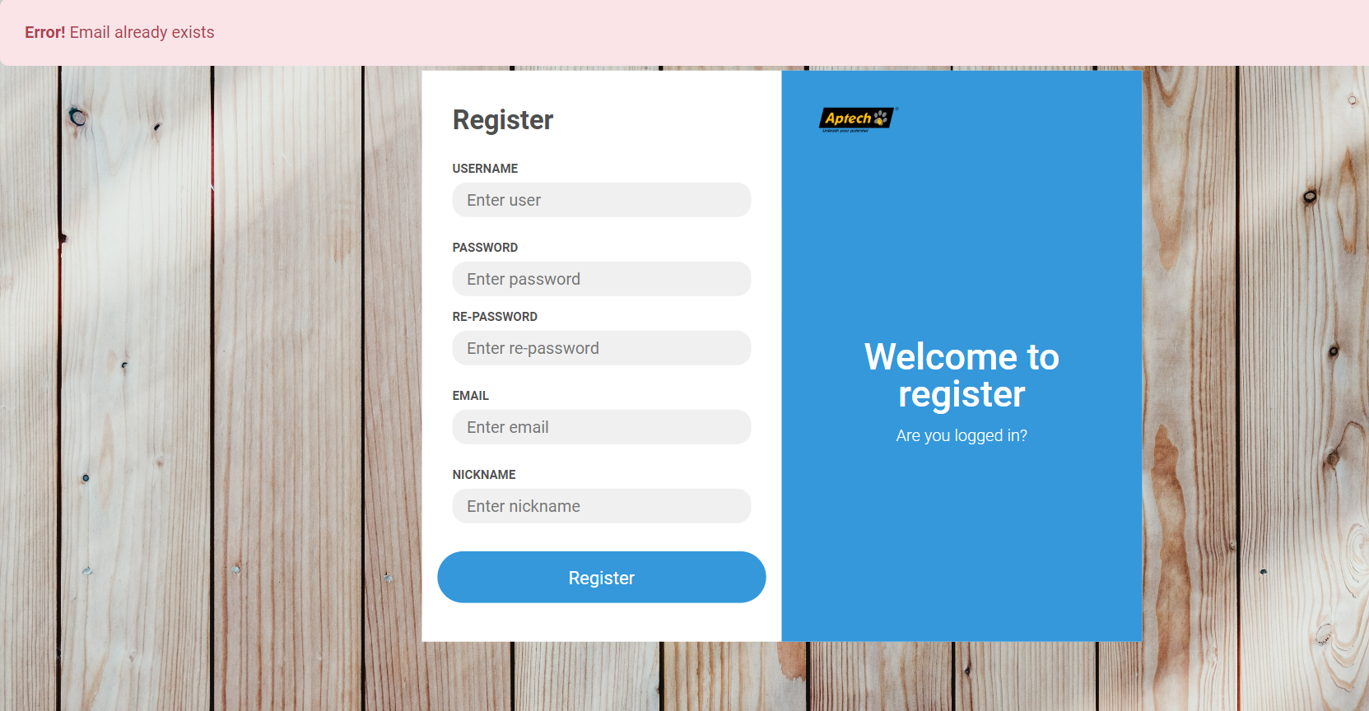
SIGN UP

Slide 14

Forgot Password

Slide 15
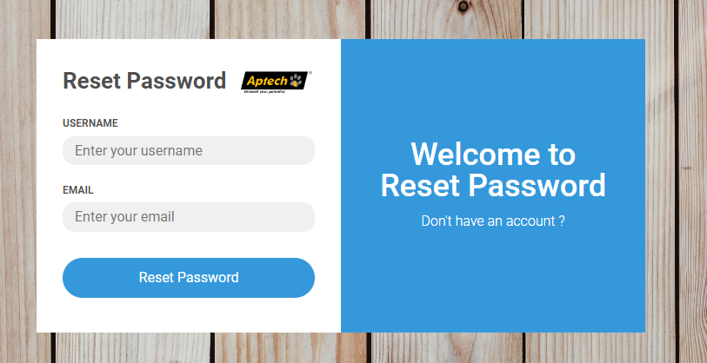
Forgot Password

Slide 16
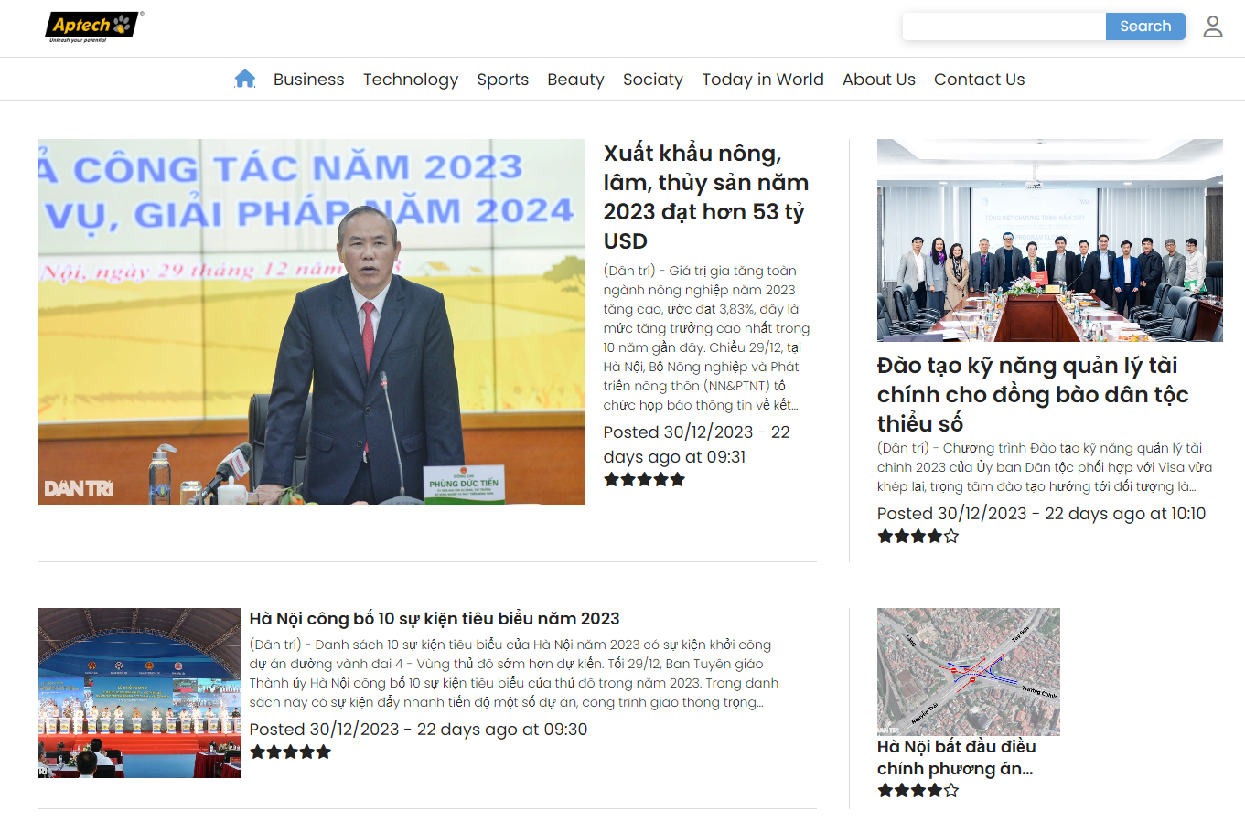
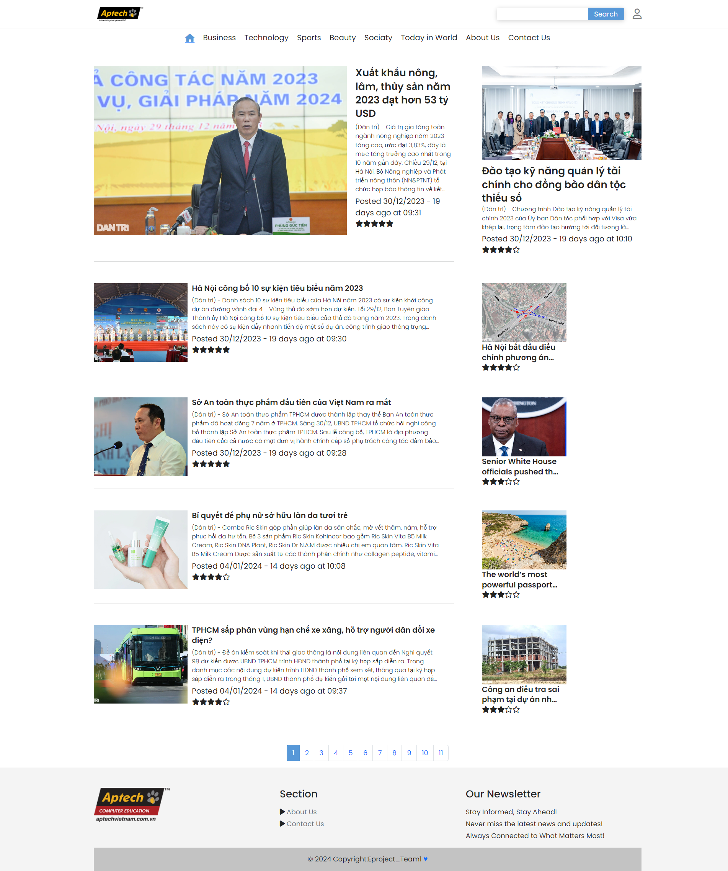
HOME PAGE
NEWS REPORTER
WEBSITE
INTERFACE
DESIGN

Slide 17
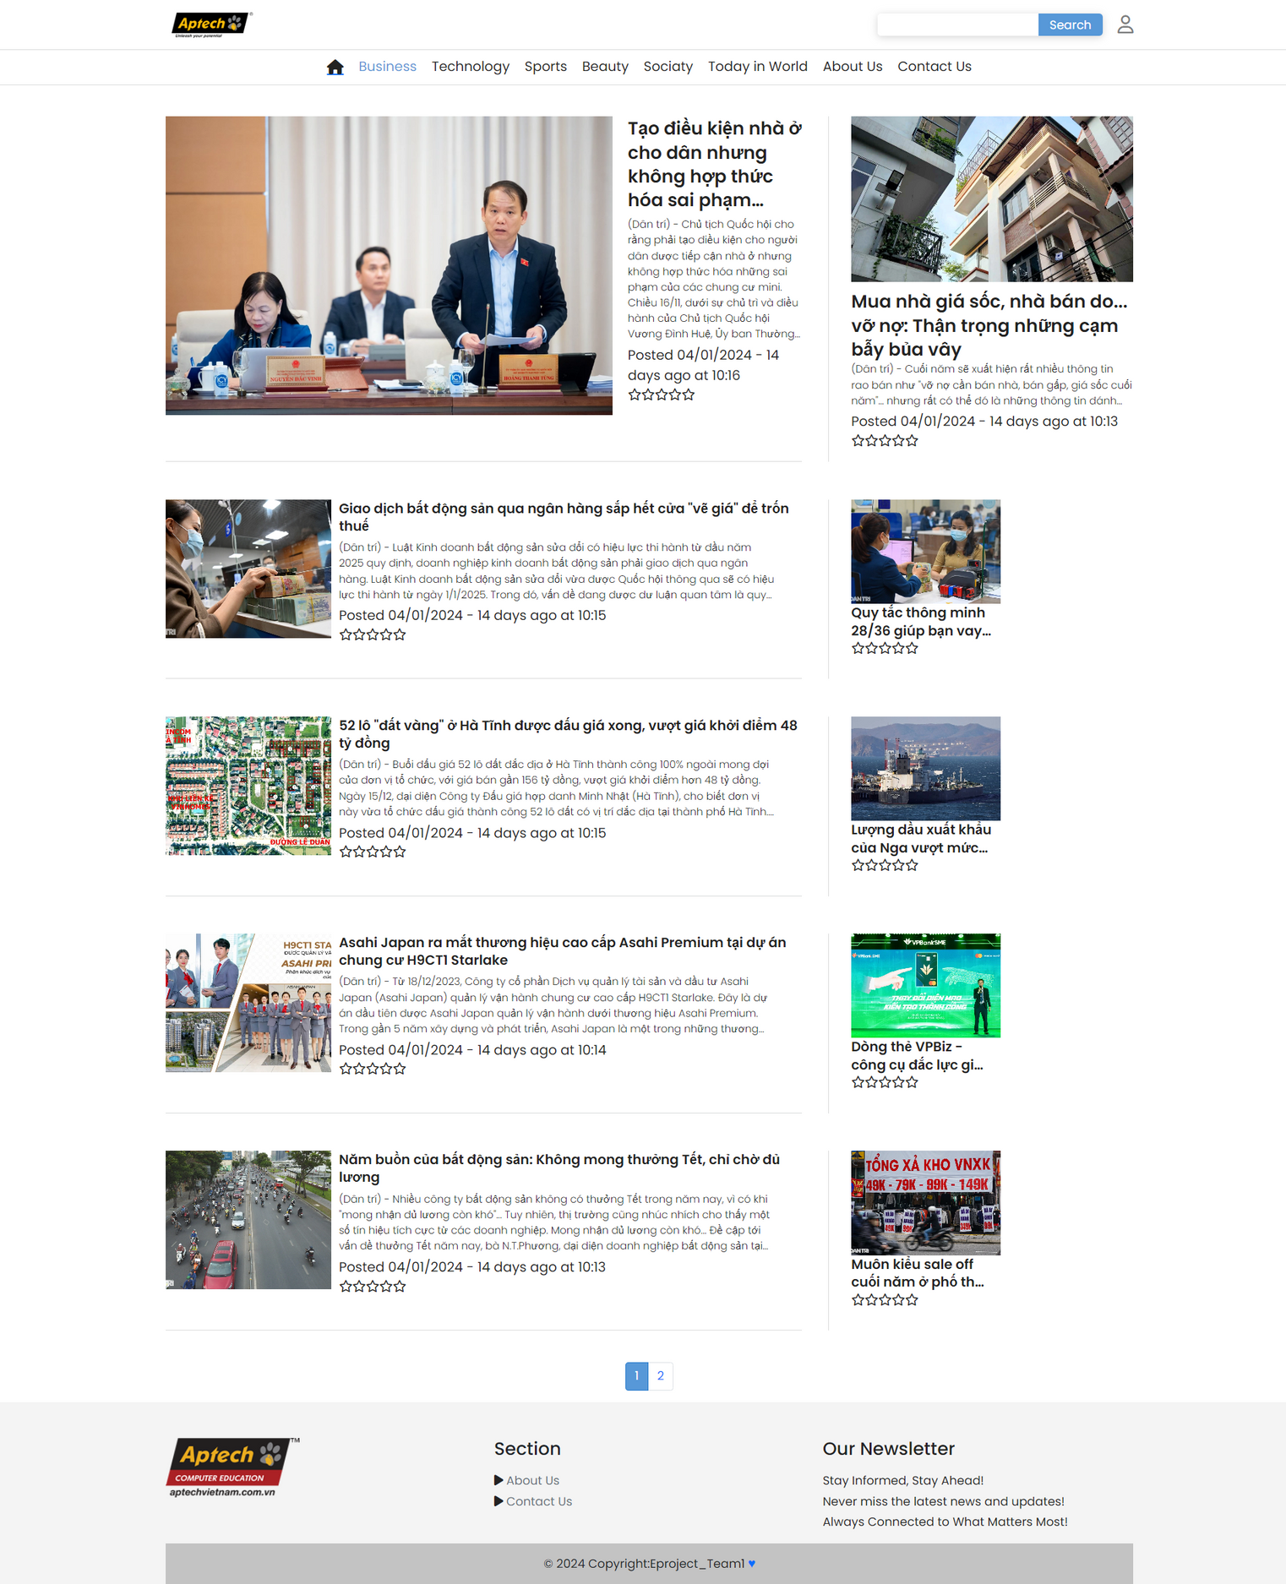
BUSINESS PAGE
NEWS REPORTER
WEBSITE
INTERFACE
DESIGN

Slide 18
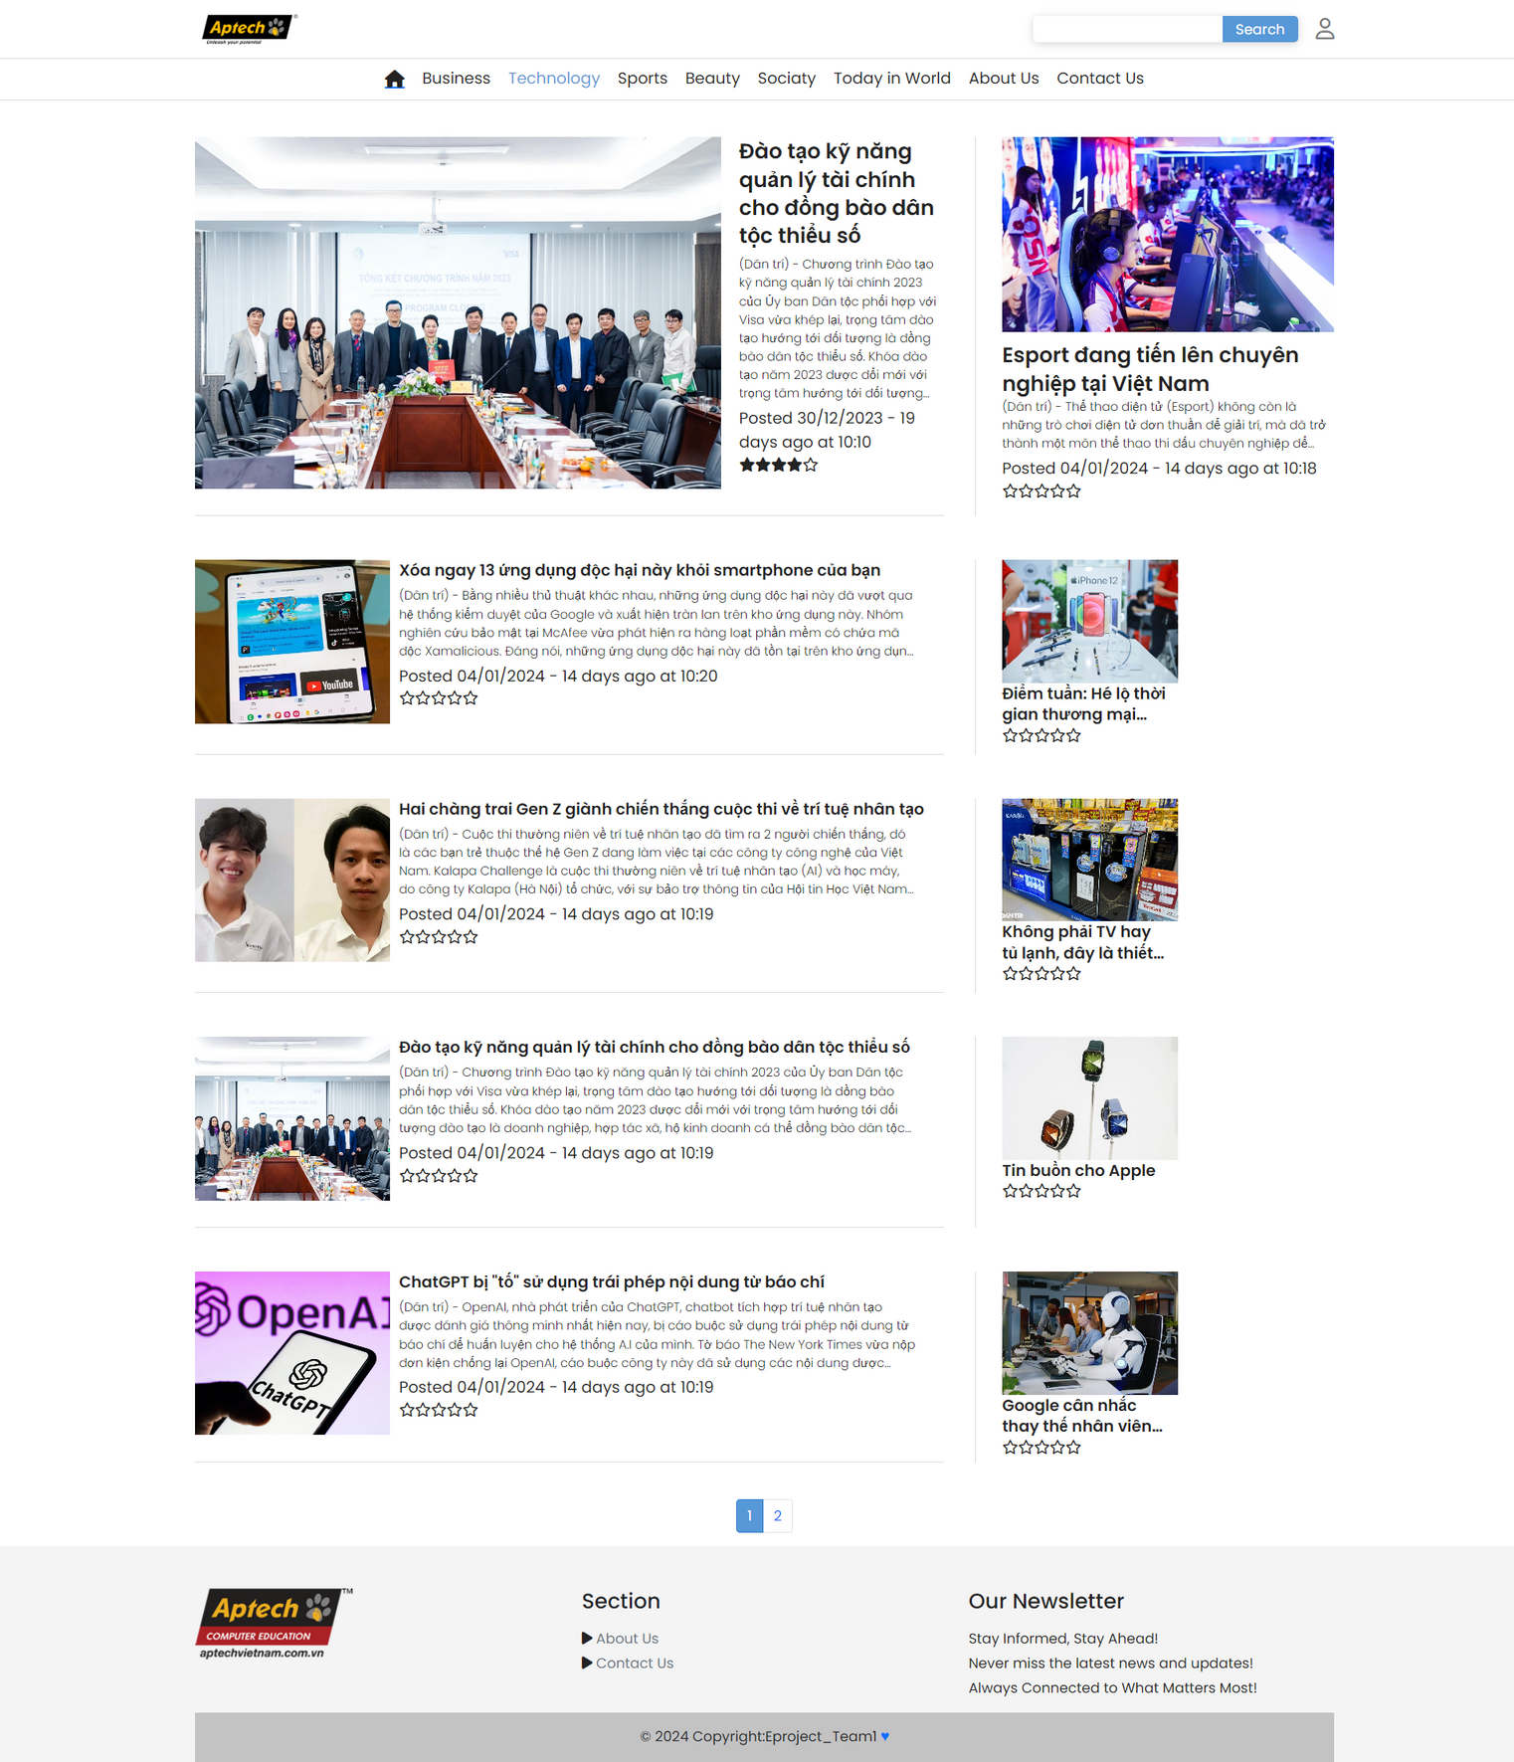
TECHNOLORY PAGE
NEWS REPORTER
WEBSITE
INTERFACE
DESIGN

Slide 19
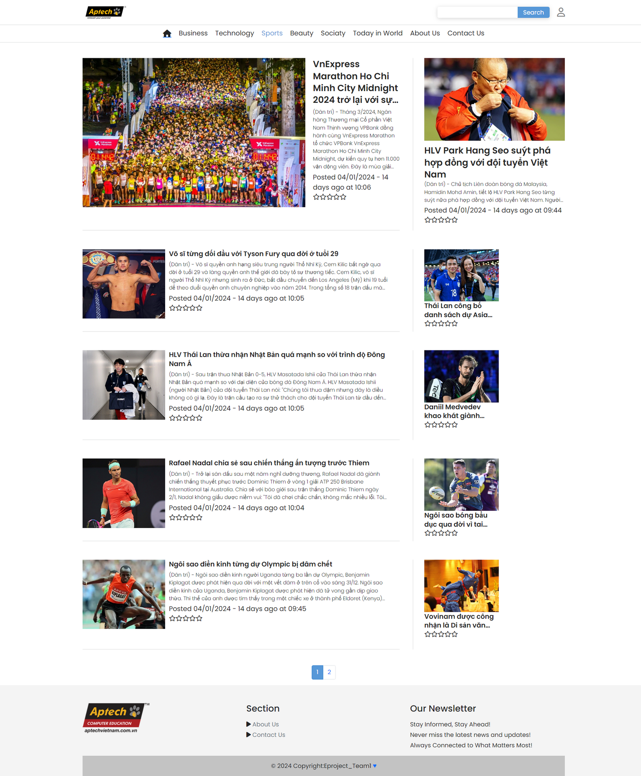
SPORTS PAGE
NEWS REPORTER
WEBSITE
INTERFACE
DESIGN

Slide 20
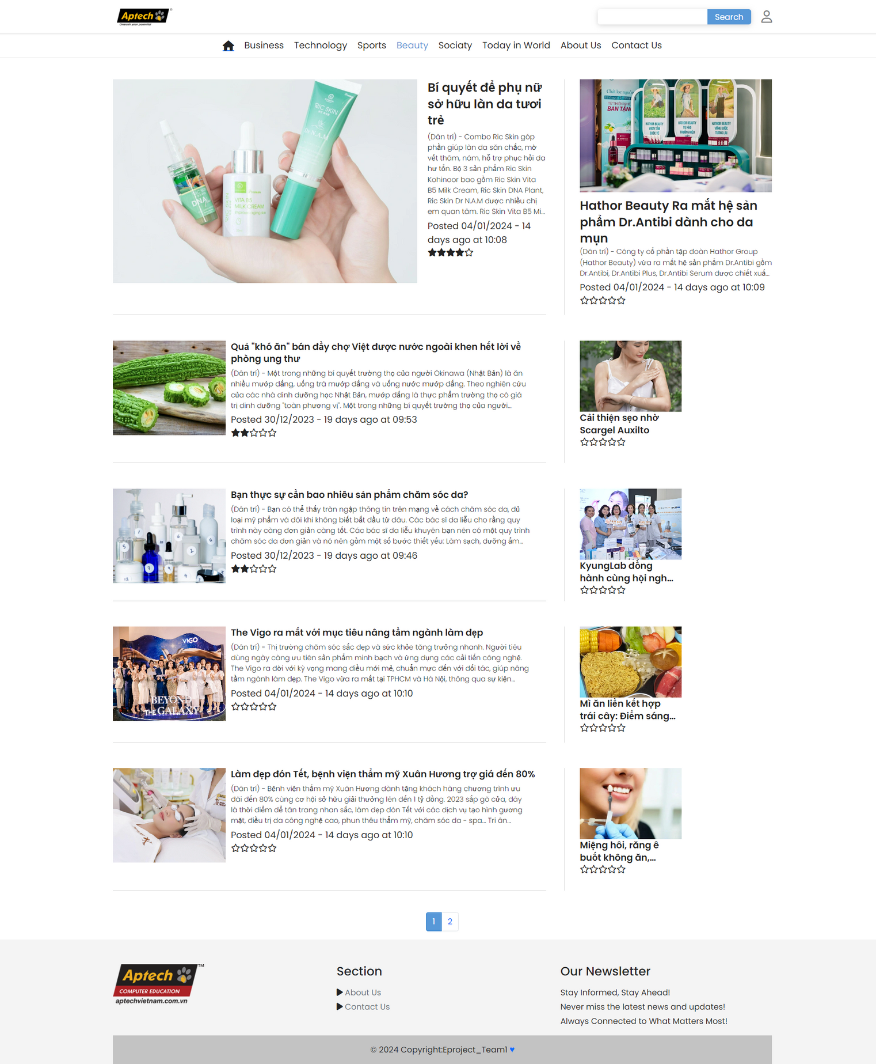
BEAUTY PAGE
NEWS REPORTER
WEBSITE
INTERFACE
DESIGN

Slide 21
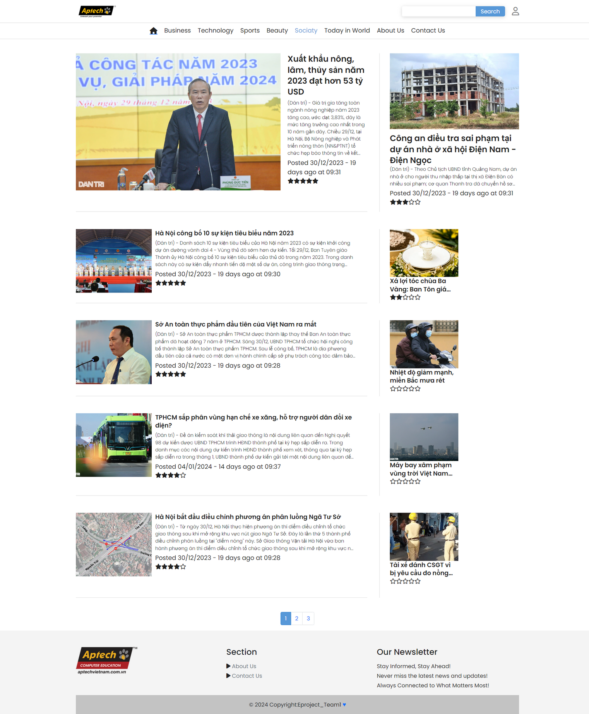
SOCIATY PAGE
NEWS REPORTER
WEBSITE
INTERFACE
DESIGN

Slide 22
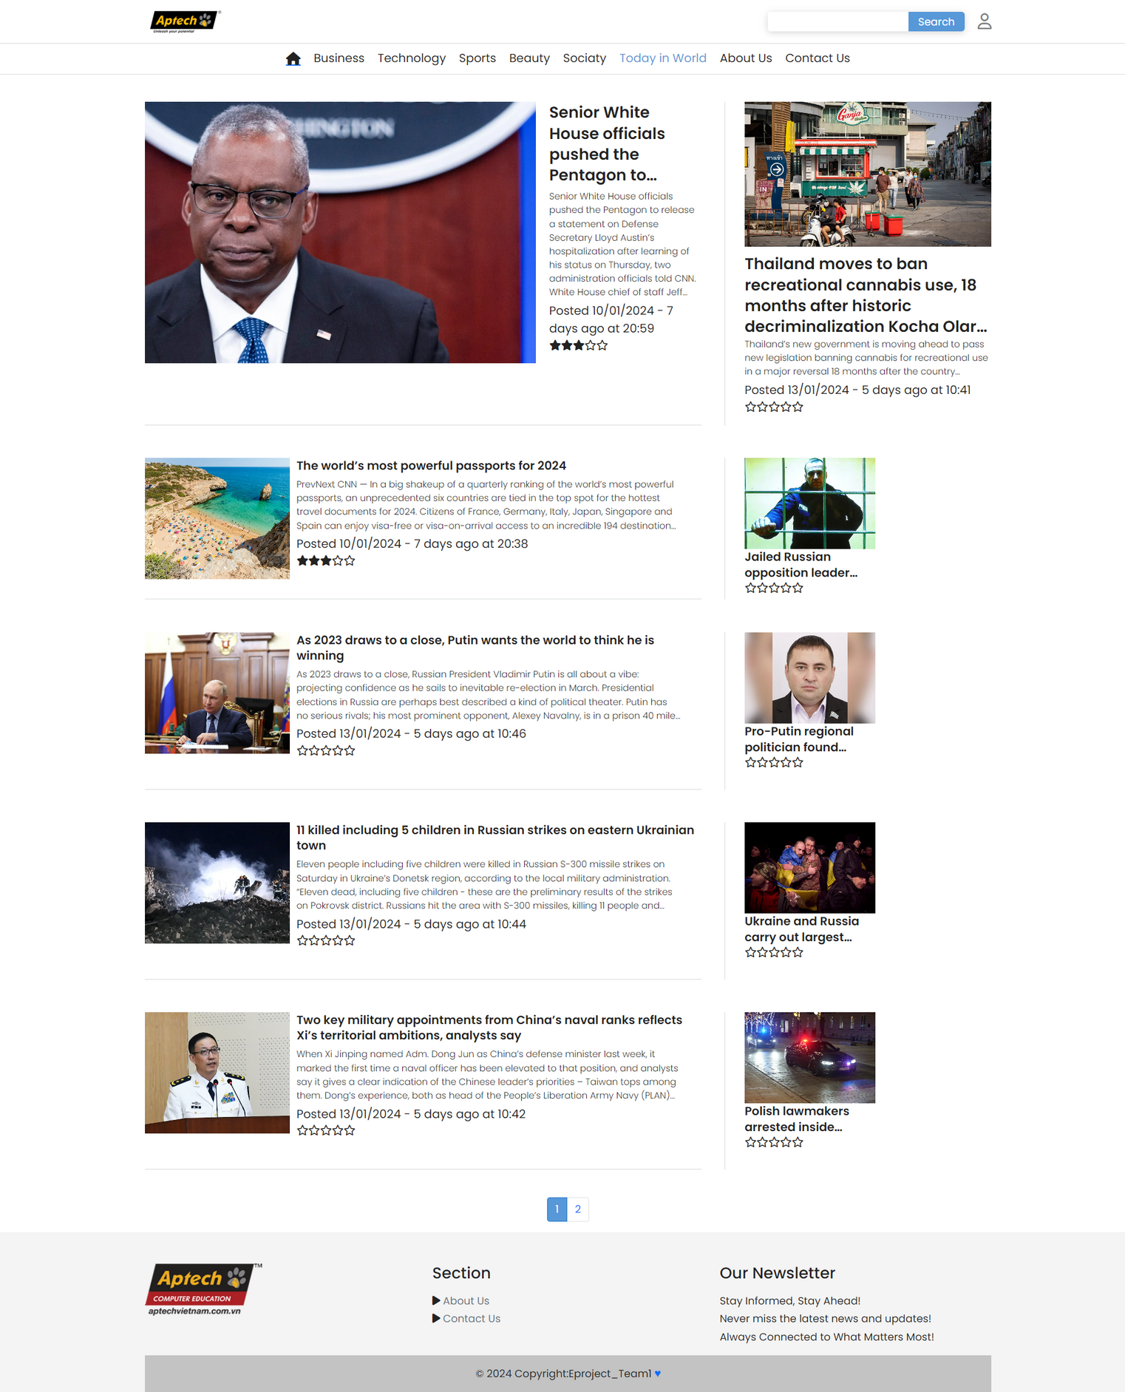
TODAY IN WORLD PAGE
NEWS REPORTER
WEBSITE
INTERFACE
DESIGN

Slide 23
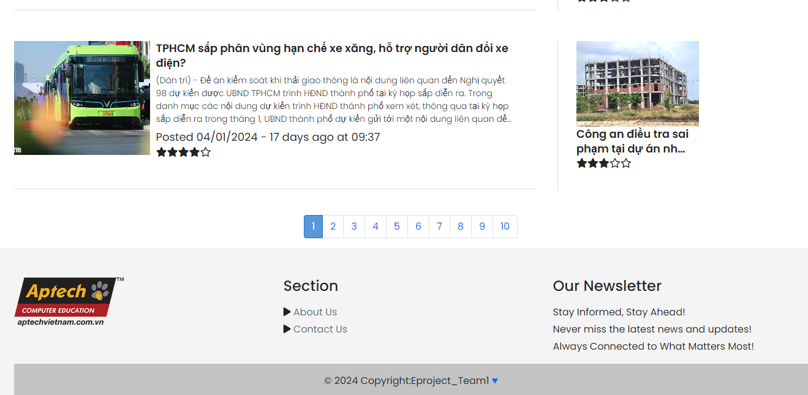
PAGINATION

Slide 24
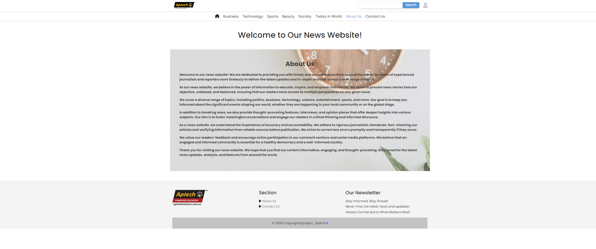
ABOUT US
NEWS REPORTER
WEBSITE
INTERFACE
DESIGN

Slide 25
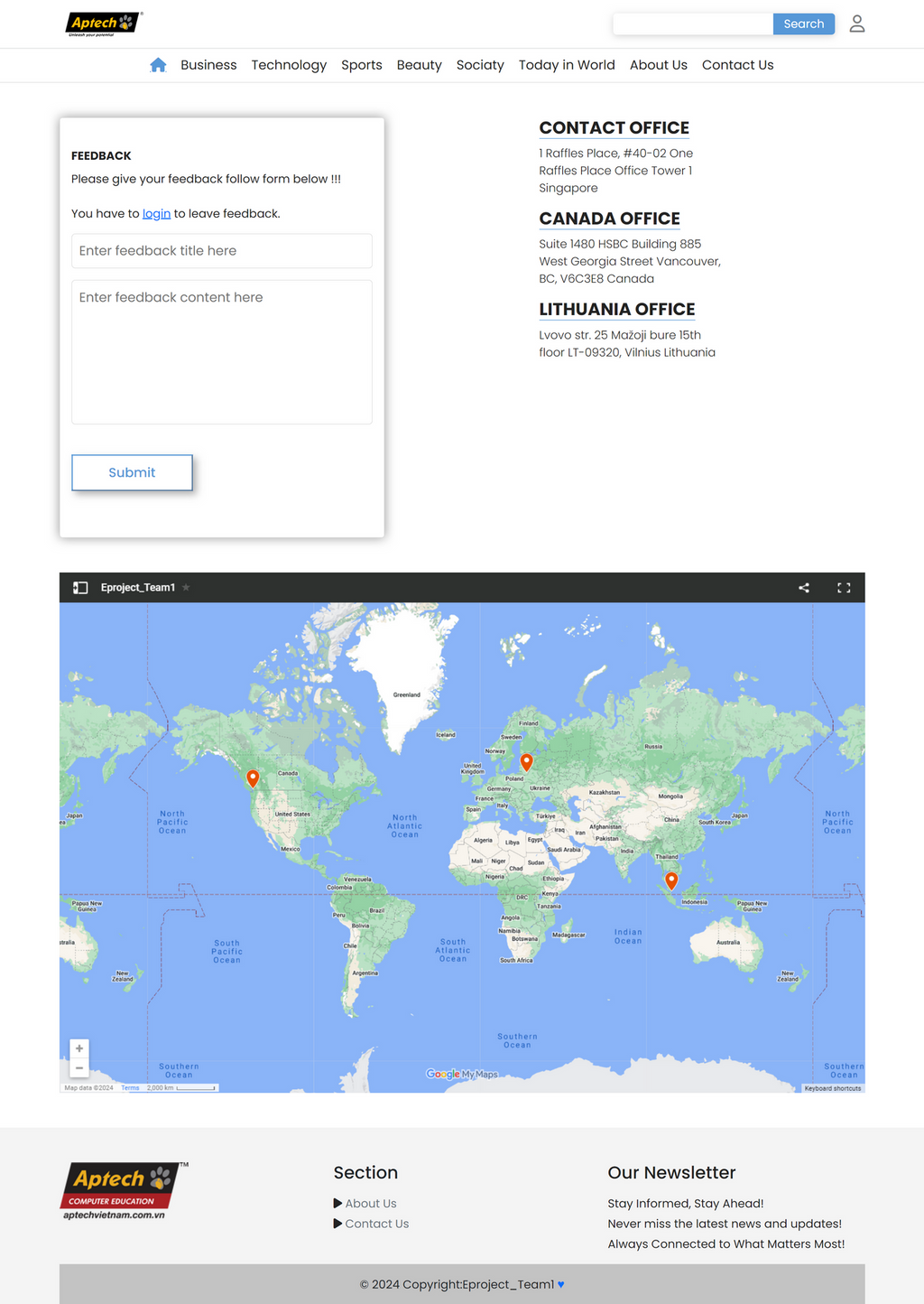
CONTACT US
NEWS REPORTER
WEBSITE
INTERFACE
DESIGN

Slide 26
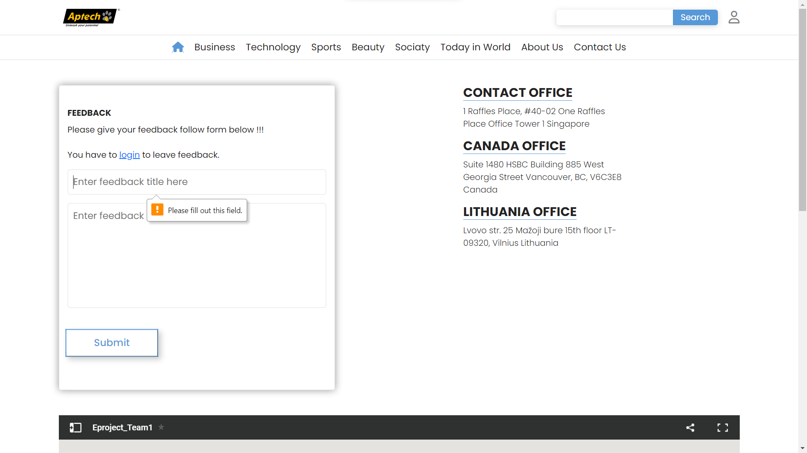
LEAVES FEEBACK

Slide 27
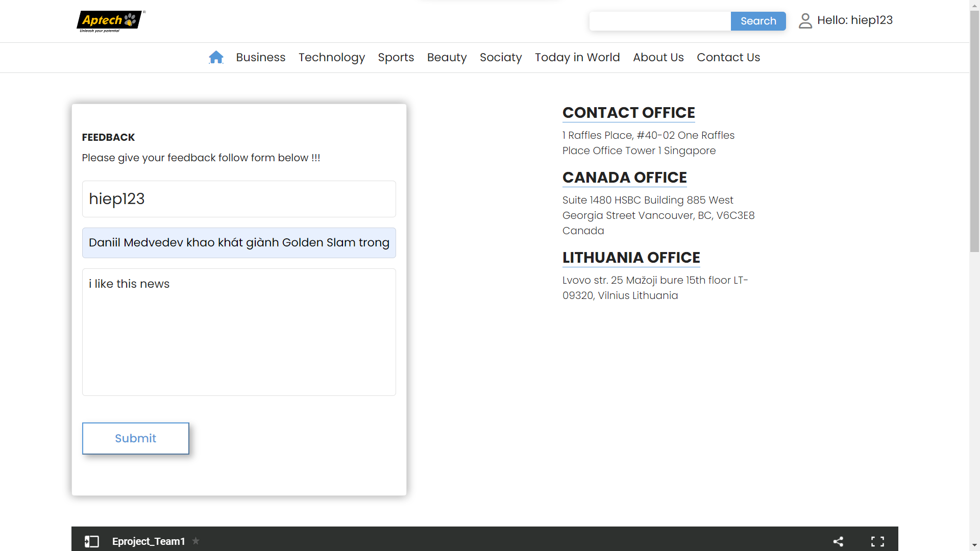

LEAVES FEEDBACK

Slide 28
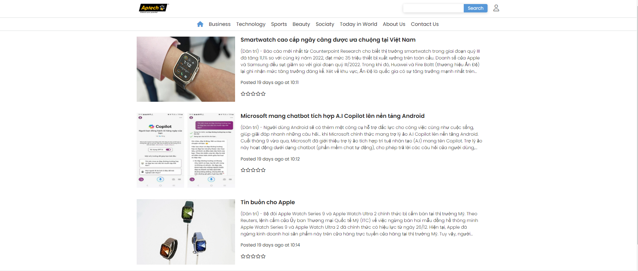
SEARCH PAGE
NEWS REPORTER
WEBSITE
INTERFACE
DESIGN

Slide 29
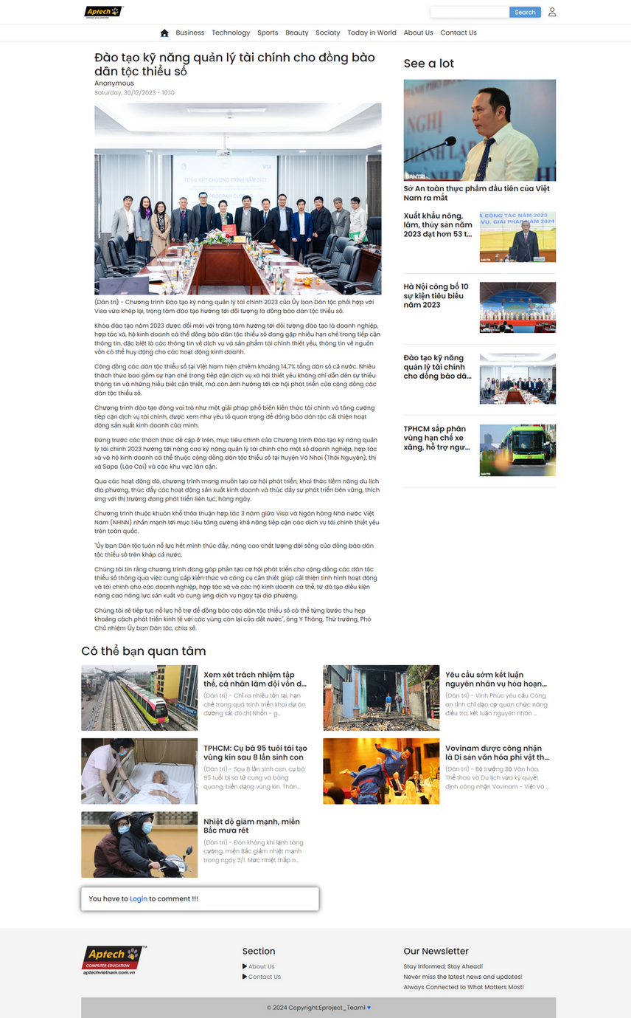
DETAIL PAGE
NEWS REPORTER
WEBSITE
INTERFACE
DESIGN

Slide 30

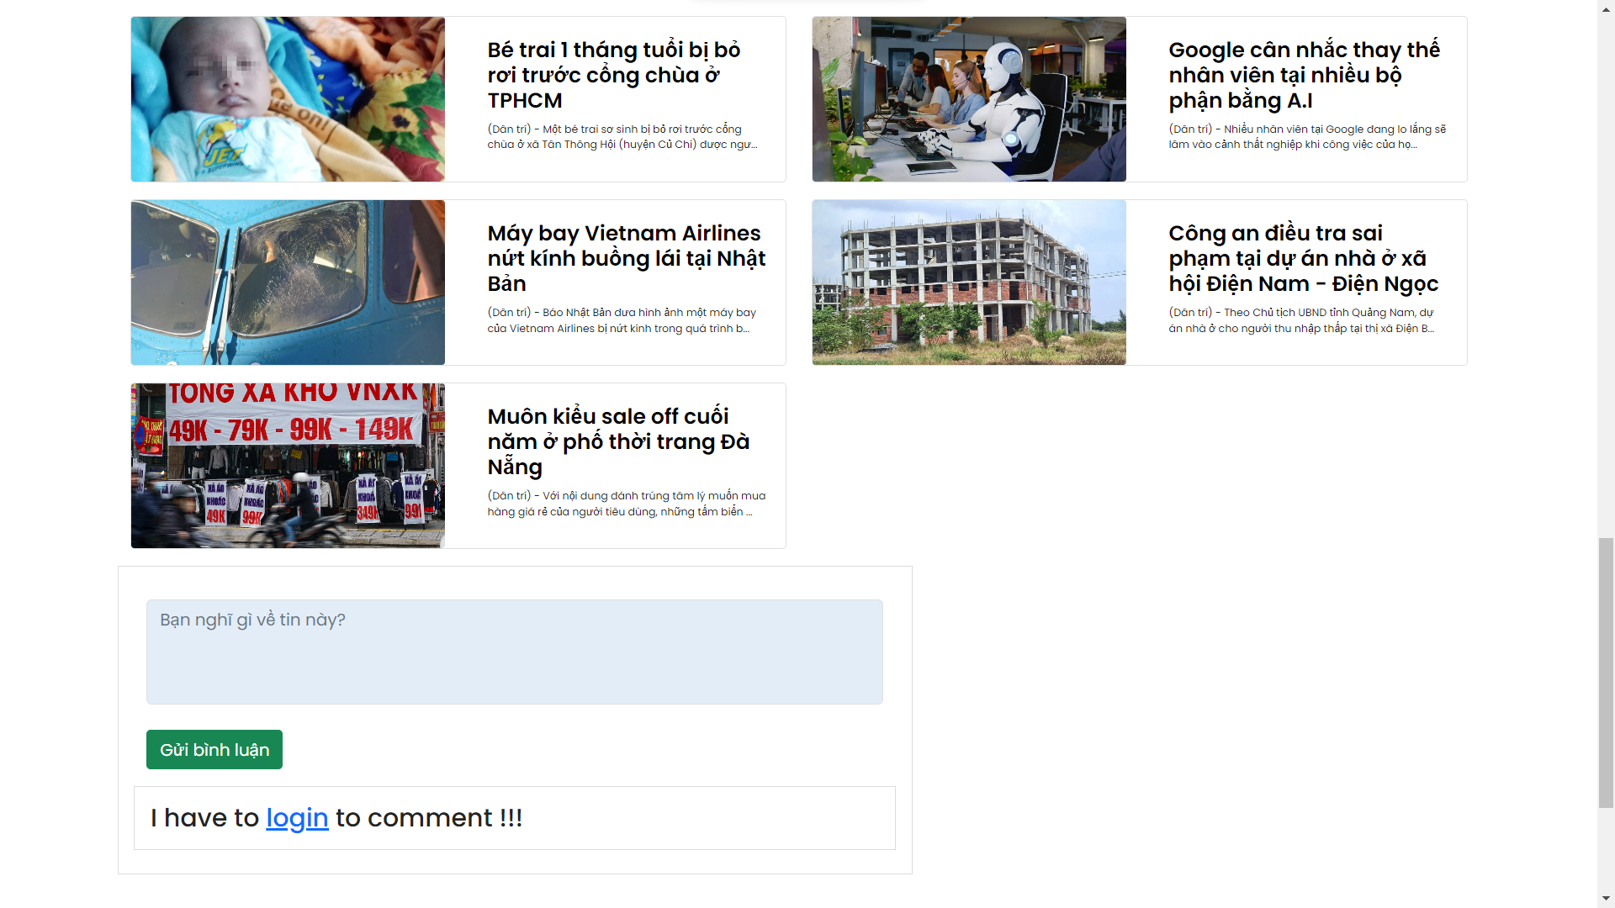
COMMENT

Slide 31
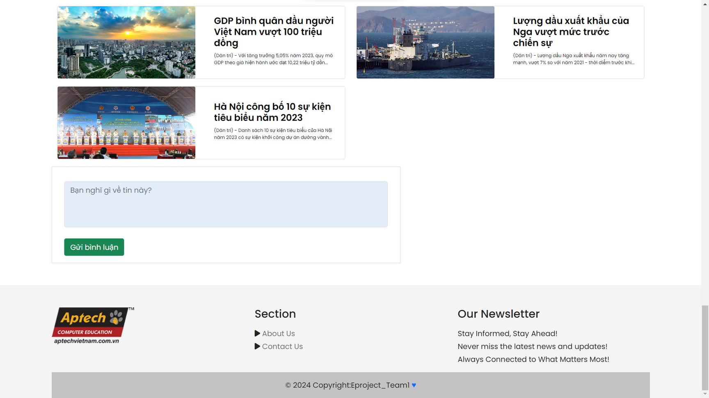
COMMENT

Slide 32

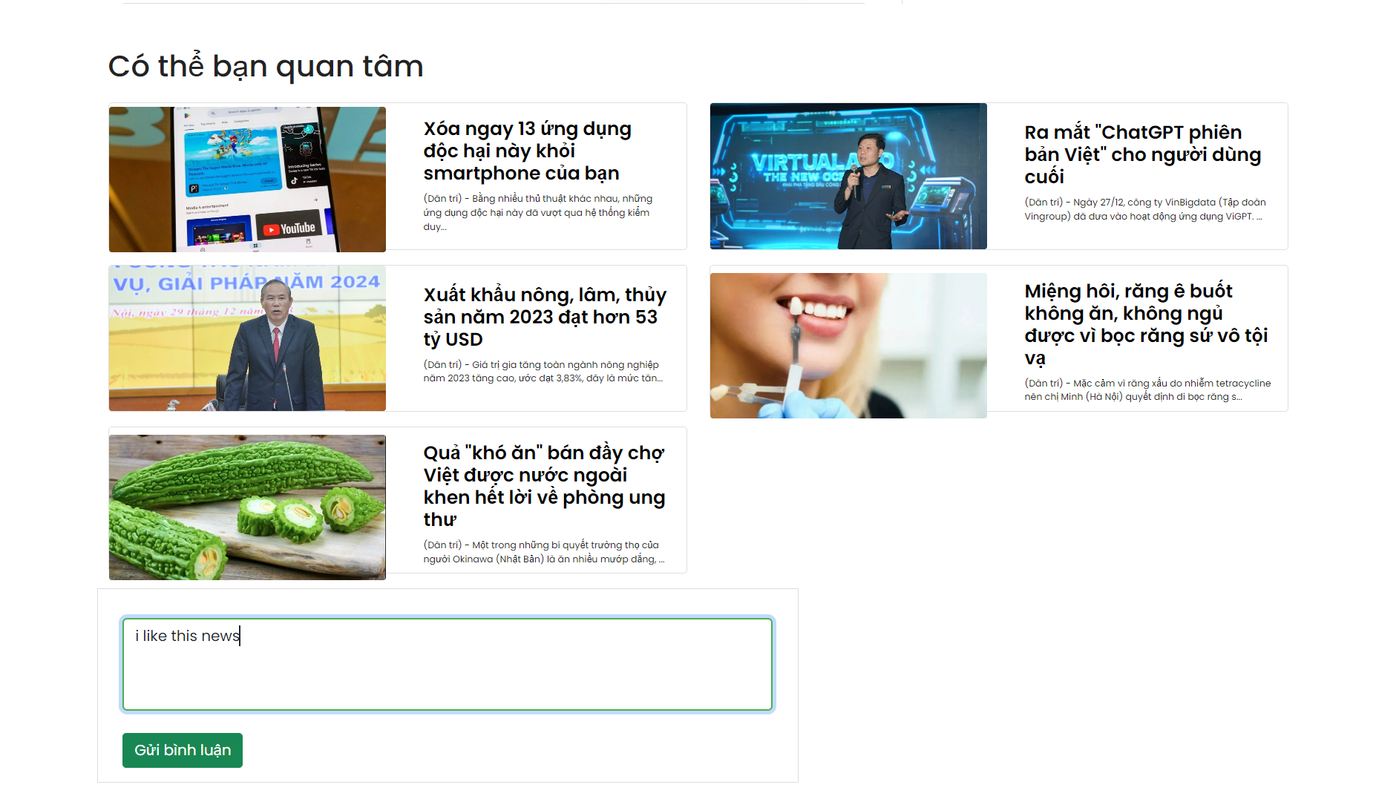
COMMENT

Slide 33

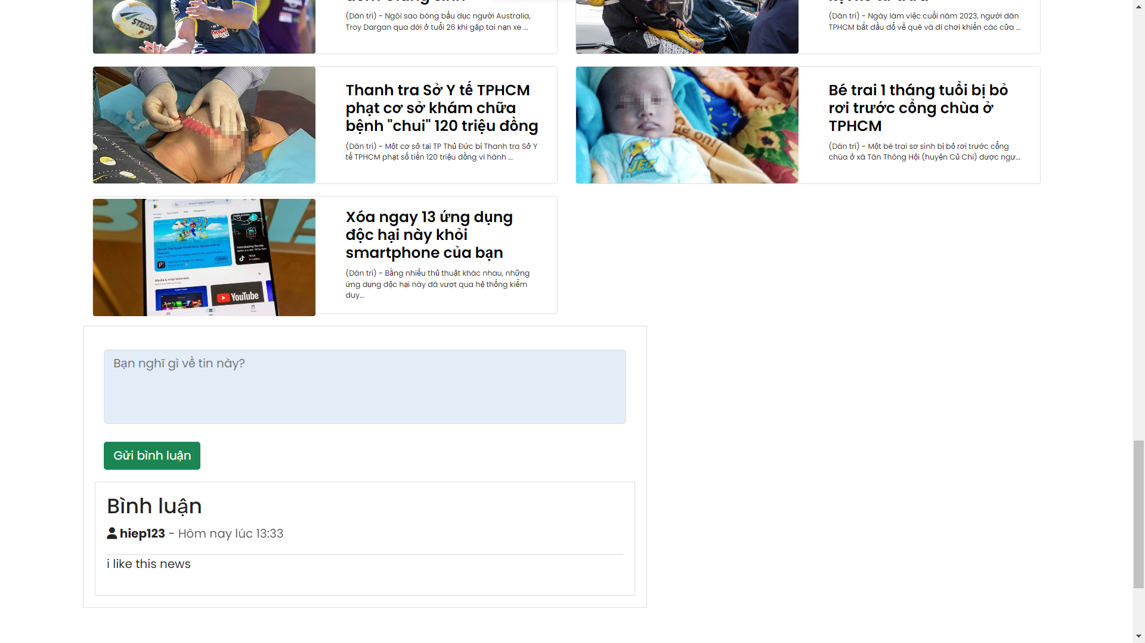
COMMENT

Slide 34
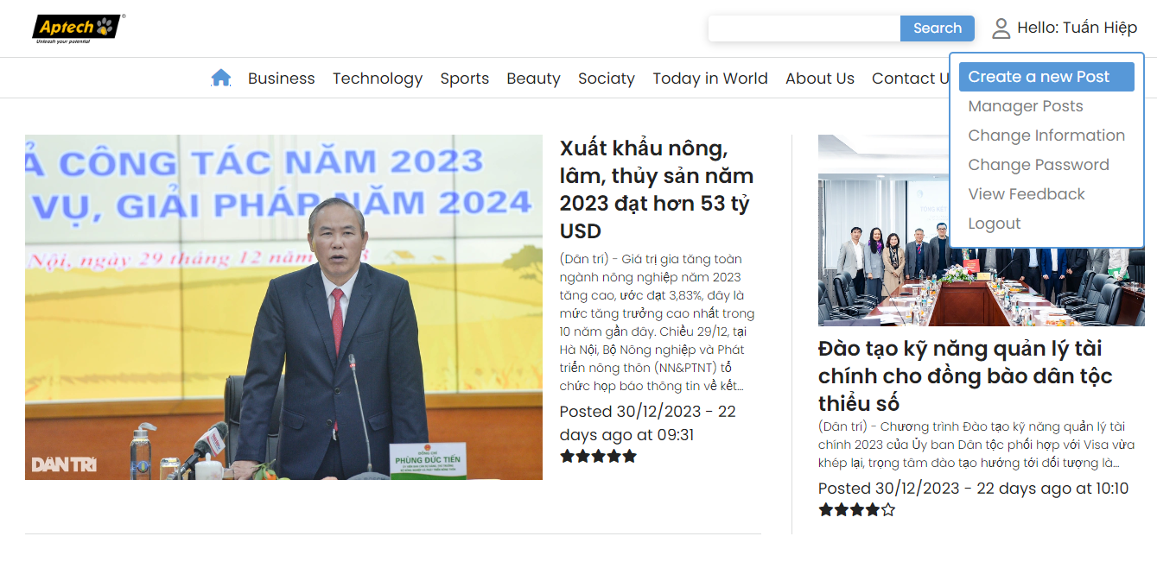
CREATE A NEW POST

Slide 35

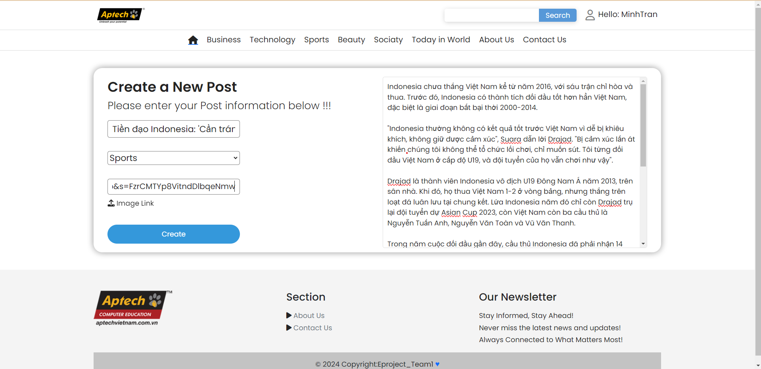
CREATE A NEW POST

Slide 36
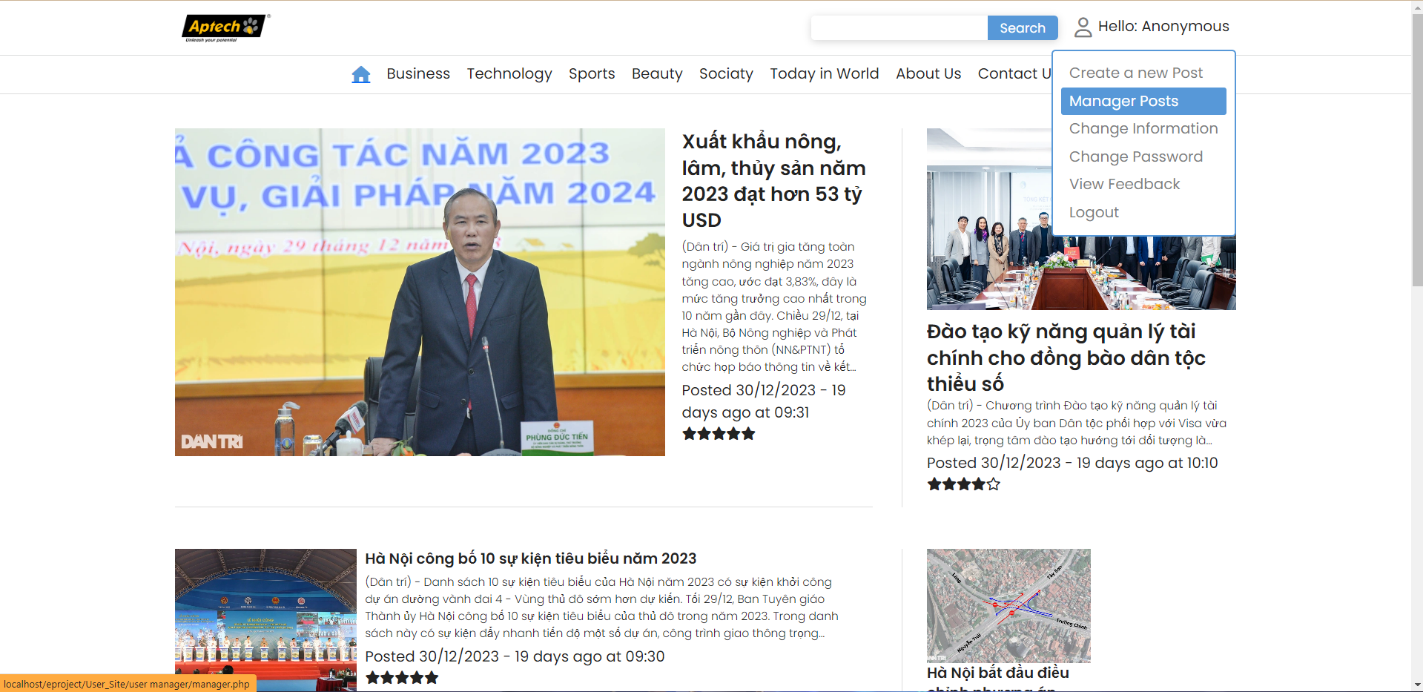
MANAGER POST

Slide 37

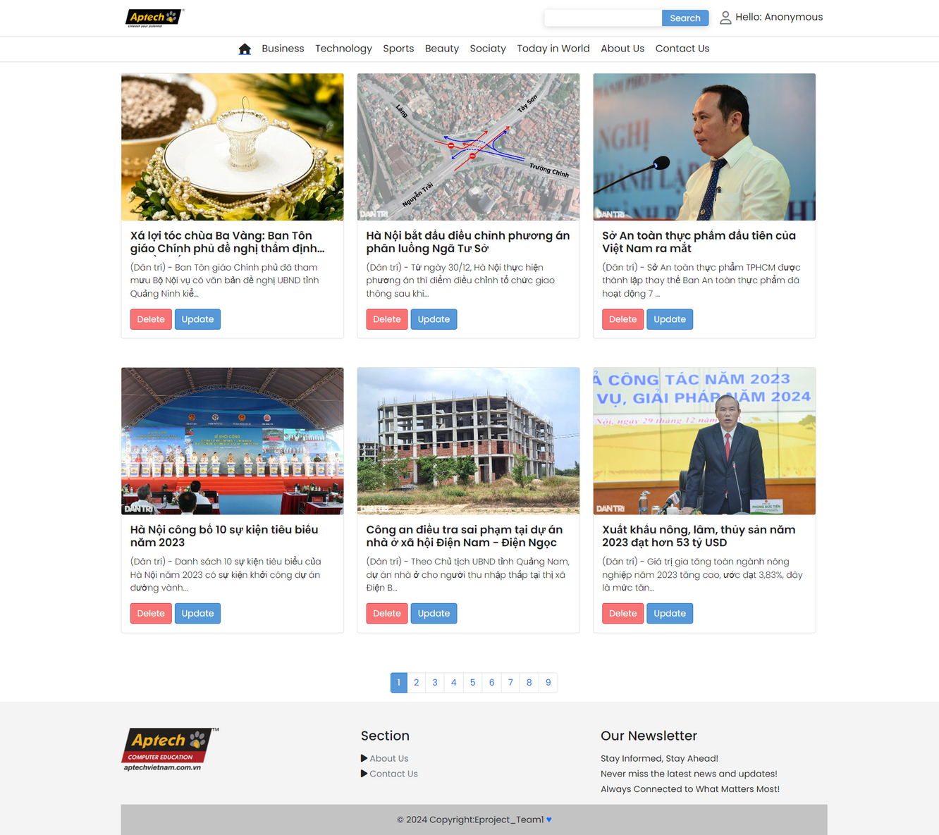
MANAGER POST

Slide 38
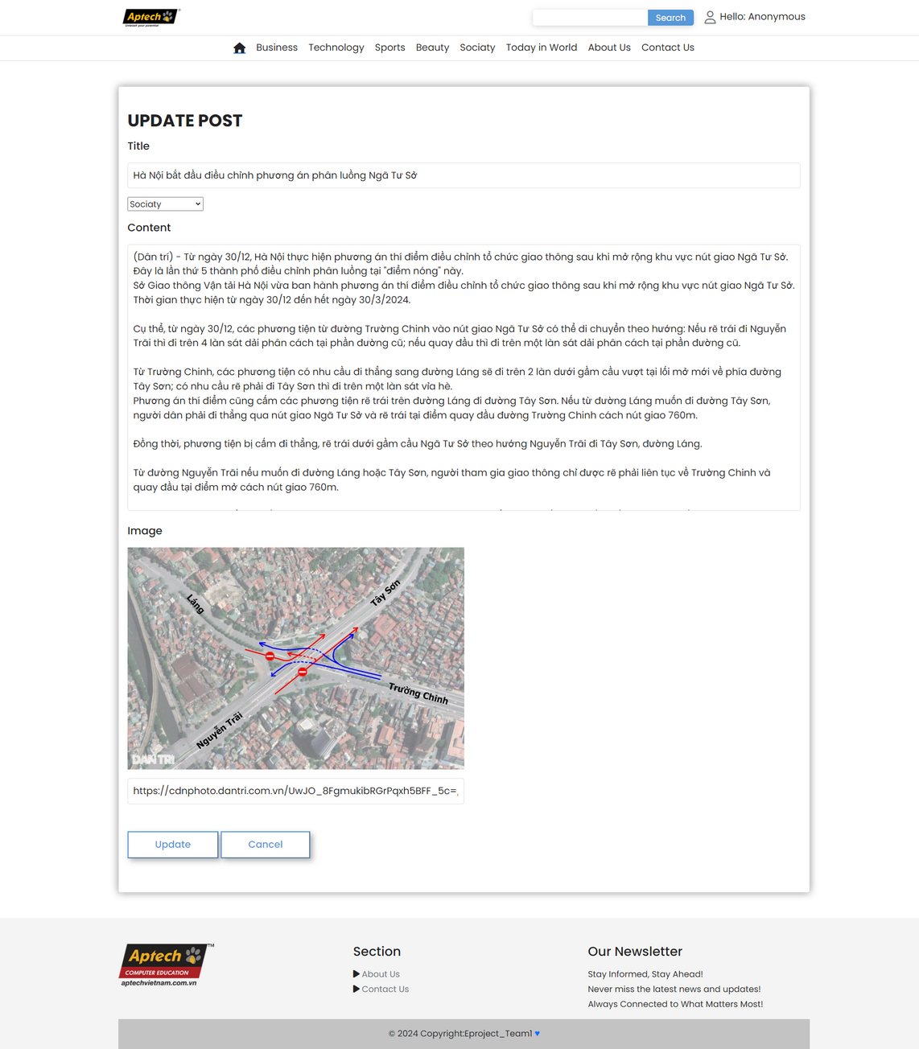
MANAGER POST

Slide 39
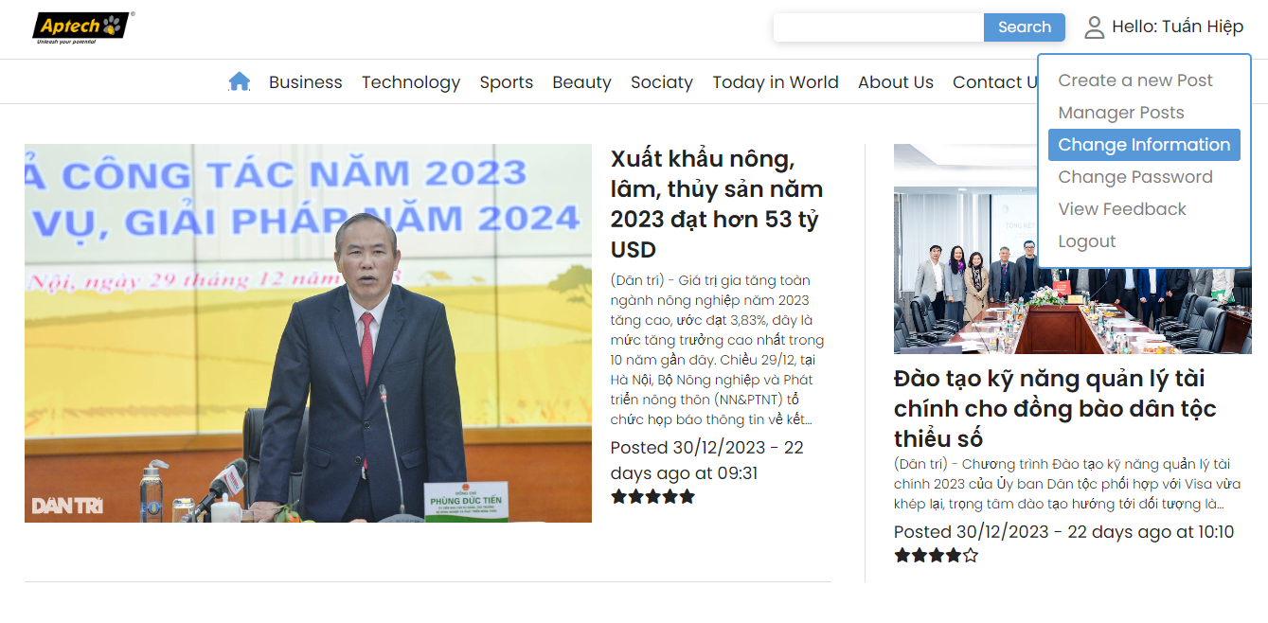
CHANGED USER INFORMATION

Slide 40

CHANGED USER INFORMATION

Slide 41
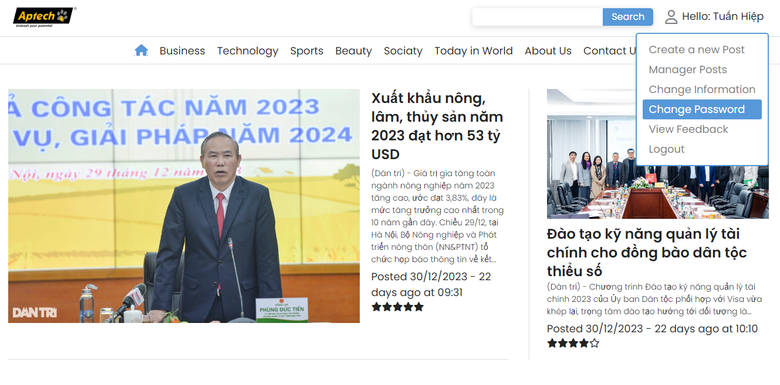
CHANGED PASSWORD

Slide 42

CHANGED PASSWORD

Slide 43
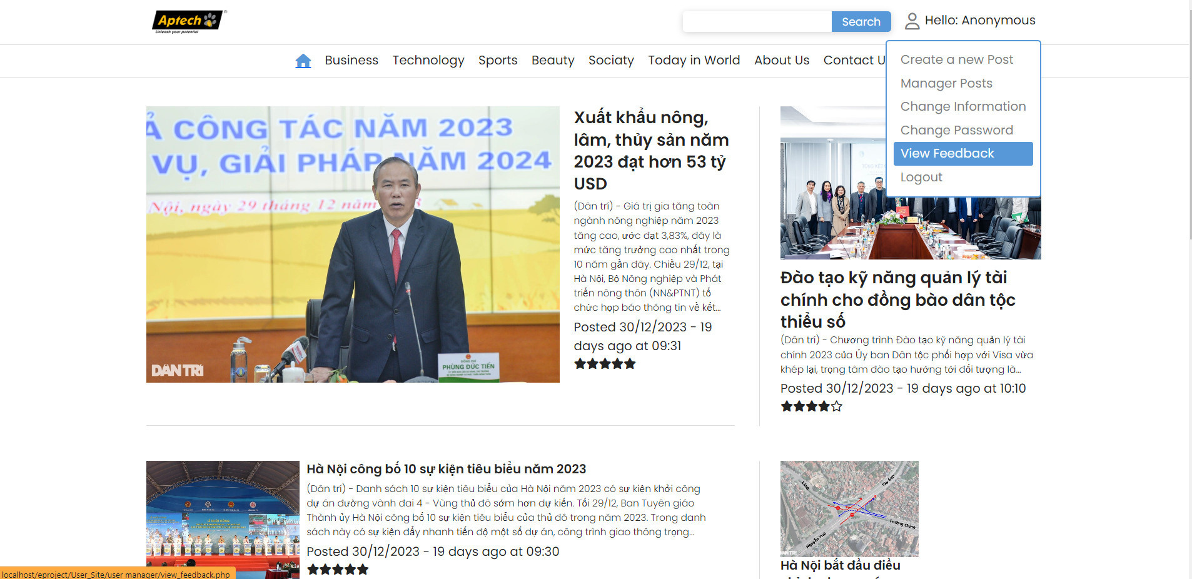
VIEW FEEDBACK

Slide 44
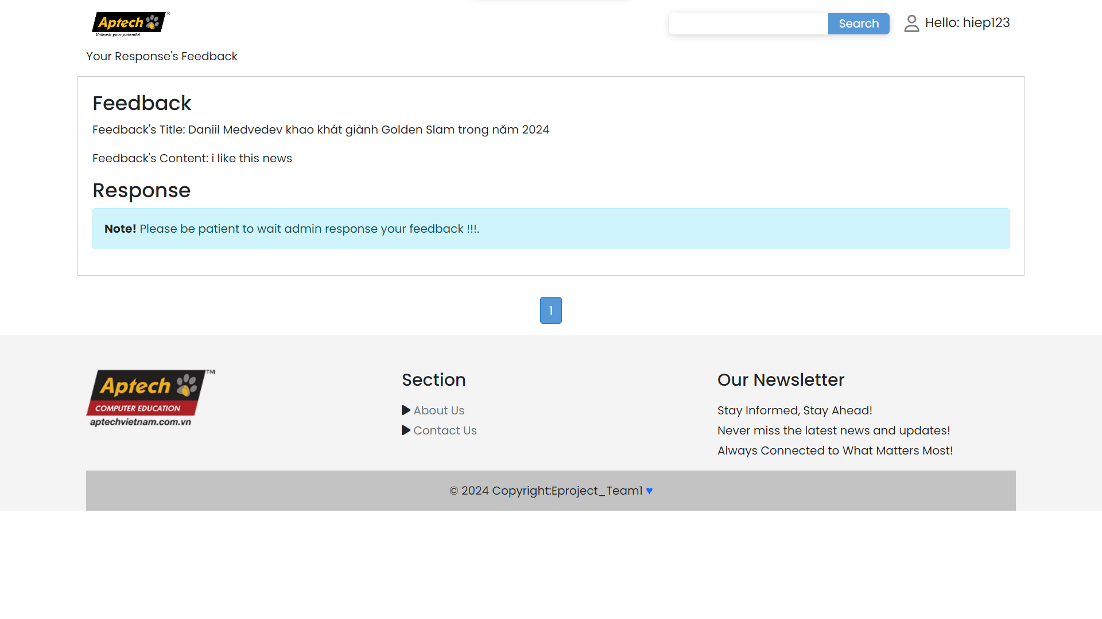
VIEW FEEBACK

Slide 45
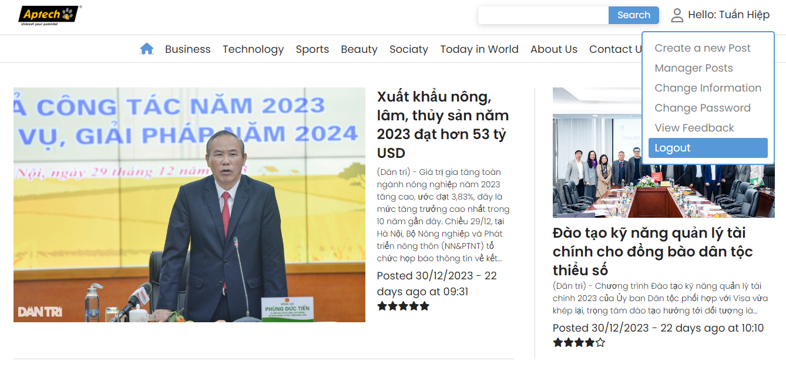
Logout

Slide 46




THANK YOU VERY MUCH!

